Slide 1



AUTOMATIC ASSESSMENT OF QUADRATIC EQUATION SOLUTIONS USING MATHBERT AND ROBERTA EMBEDDINGS
Authors: Subhiksha Suresh Rao, Sahil Mishra, S Akhilesh, Roshni M Balakrishnan and Peeta Basa Pati

Slide 2

PROBLEM STATEMENT
Addresses the challenge of evaluating quadratic equations.
Traditional methods of assessment often require significant human intervention.

Slide 3
INTRODUCTION
Need for Automation
Growing technology use in education necessitates reliable automated classification systems.
Machine Learning-Based System
Development of an automated system using recent advancements in machine learning and natural language processing.
Utilizes MathBERT embeddings for rich semantic information and high-dimensional vector representation.

Slide 4
BACKGROUND
Challenges in Traditional Grading
Manual grading is labor-intensive, subjective, and inconsistent
Previous Research
Limited focus on using advanced NLP models for mathematical content.
Initial studies indicate potential benefits but lack comprehensive solutions.

Slide 5
Research Questions Addressed
Solutions this paper addresses the following research questions: RQ1) How does the embeddings generated by MathBERT perform compared to that of RoBERTa in classifying the quadratic solutions? RQ2) Does application of PCA affect the results? RQ3) Which ensembling technique shows the best performance?

Slide 6
TECHNICAL DETAILS
Dataset Used: Incorrect, Partially Correct, and Correct.
Preprocessing Steps:
Feature engineering and preparation using MathBERT and RoBERTa
Dimensionality reduction using PCA.
Algorithms Implemented:
Traditional classification models
Meta-model created by bagging SVM and MLP.
Performance Metrics:
The models are evaluated using F1-score, accuracy, precision, and recall.

Slide 7
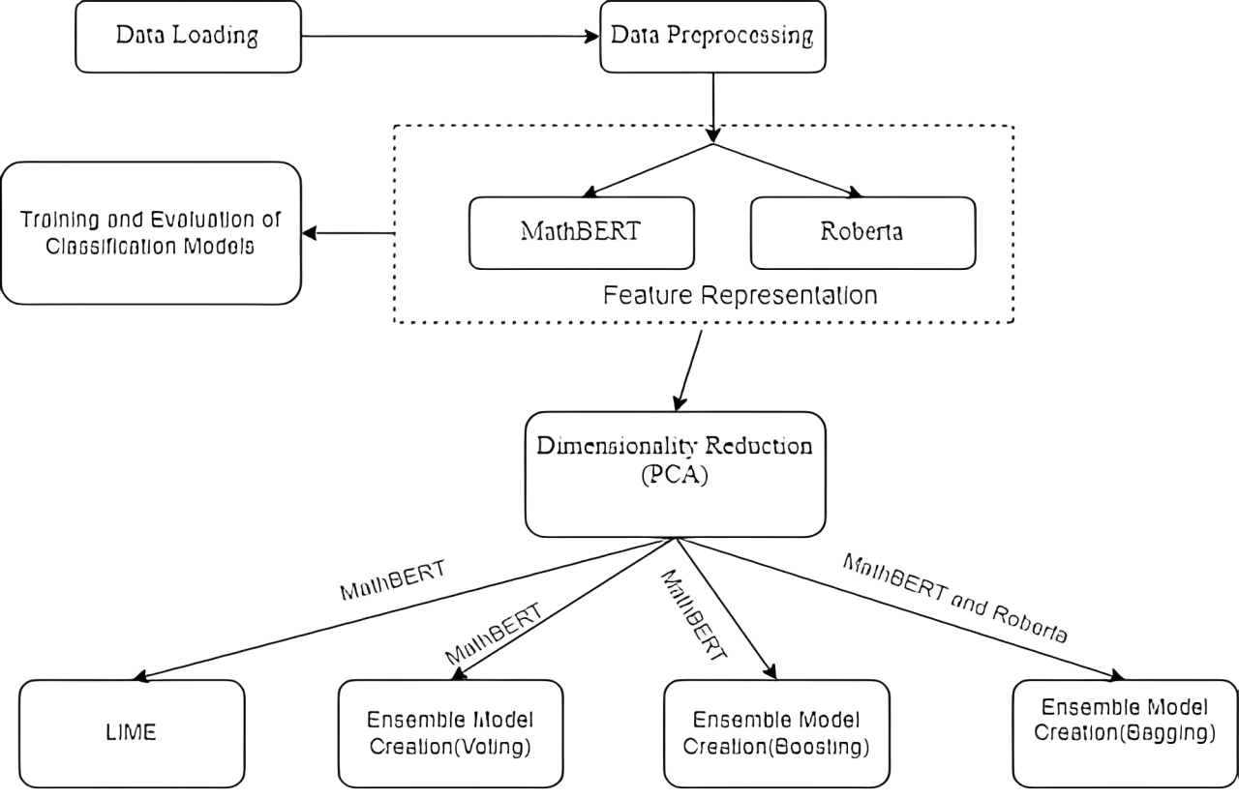
METHODOLOGY:

Slide 8
METHODOLOGY:
Features are engineered using MathBERT and RoBERTa embeddings to convert textual solutions into high-dimensional vector representations.
The models are trained using multi-class classification techniques. Techniques like ensemble meta models (Stacking, Voting, and Boosting) are employed to enhance performance.
Hyperparameter tuning and cross-validation methods are used to optimize the models.
Models are cross-validated using standard metrics (accuracy, precision, recall, F1-score) to ensure robustness.
Techniques like LIME are used to provide transparency and interpretability in model decisions.

Slide 9
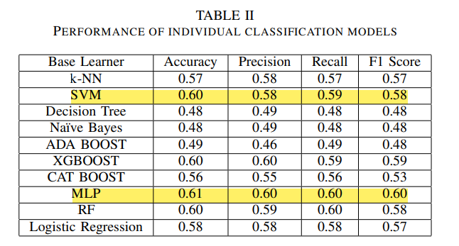
RESULT ANALYSIS – Traditional Classifiers

Slide 10
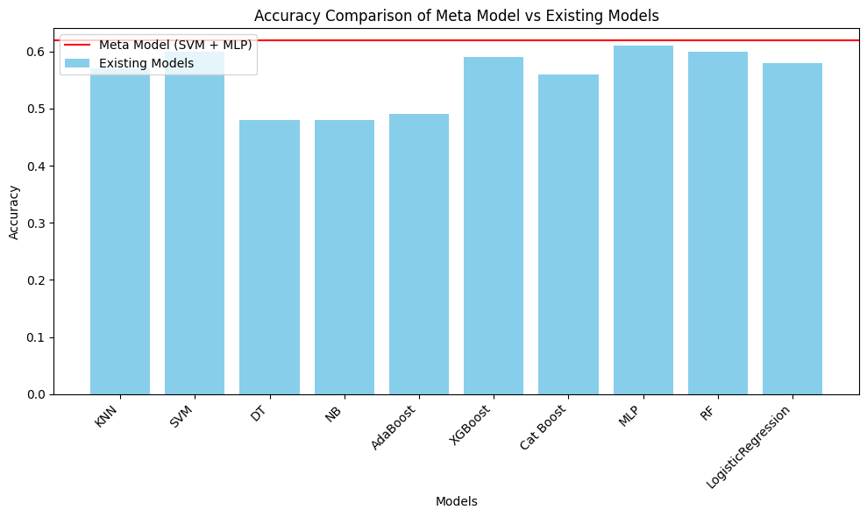
Comparison of SVM-MLP Bagging With Existing Models

Slide 11
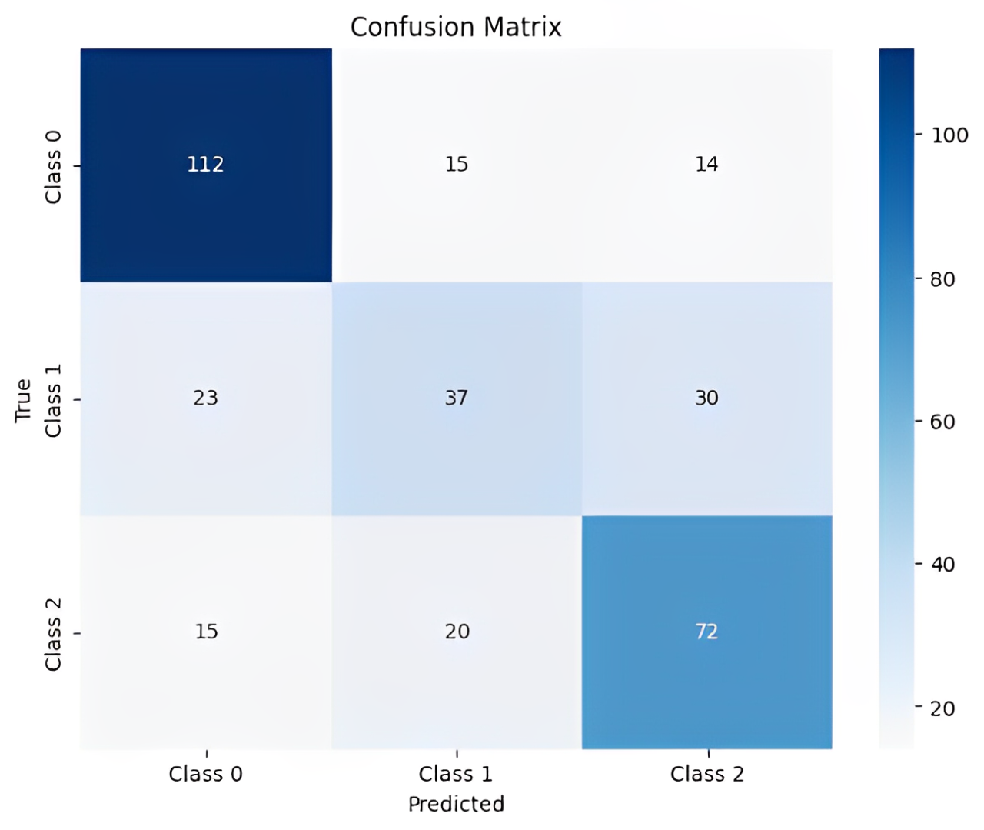
Confusion Matrix of The SVM-MLP Bagging
Accuracy of the model: 65%

Slide 12
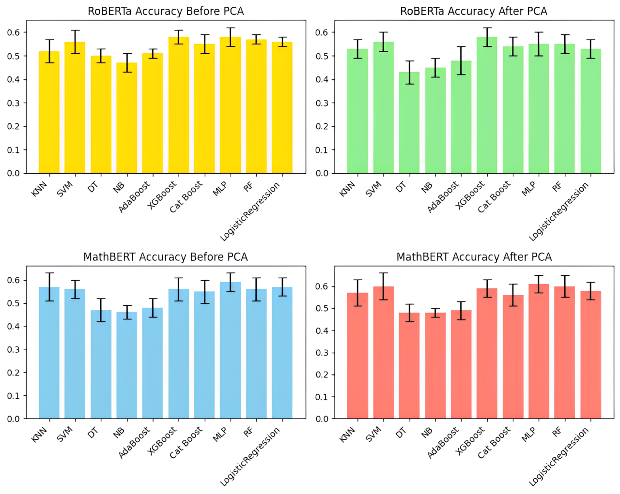
Impact of PCA

Slide 13
CONCLUSION
Summary of Findings:
MathBERT embeddings outperformed RoBERTa embeddings in classifying quadratic solutions.
The proposed meta-model showed better accuracy.
PCA effectively improved model efficiency and accuracy.
Future Work:
Explore other NLP models for improved vectorization techniques.
Integration into educational platforms for real-time feedback.
Extend methodology to other mathematical areas for comprehensive evaluation.

Slide 14
REFERENCES
[1] Likforman-Sulem, L., Hanimyan, A. and Faure, C., 1995, August. A Hough based algorithm for extracting text lines in handwritten documents. In Proceedings of 3rd international conference on document analysis and recognition (Vol. 2, pp. 774-777). IEEE.
[2] Yin, F. and Liu, C.L., 2007, November. Handwritten text line extraction based on minimum spanning tree clustering. In 2007 international conference on wavelet analysis and pattern recognition (Vol. 3, pp. 1123- 1128). IEEE.
[3] Varga, T. and Bunke, H., 2005, August. Tree structure for word extraction from handwritten text lines. In Eighth International Conference on Document Analysis and Recognition (ICDAR’05) (pp. 352-356). IEEE.
[4] Proceedings Volume 12174, International Conference on Internet of Things and Machine Learning (IoTML 2021); 121740X (2022) https://doi.org/10.1117/12.2628649 Event: International Conference on Internet of Things and Machine Learning (IoTML 2021), 2021, Shanghai, China
[5] Improving Automated Scoring of Student Open Responses in Mathematics-Sami Baral, Anthony F Botelho, John A Erickson, Priyanka Benachamardi, Neil T Heffernan.
[6] Li, Minli & Zhao, Peilin & Zhang, Yifan & Niu, Shuaicheng & Wu, Qingyao & Tan, Mingkui. (2021). Structure-aware Mathematical Expression Recognition with Sequence-Level Modeling. 5038-5046. 10.1145/3474085.3475578.
[7] A Robust Methodology for Creating Large Image Datasets Using a Universal Format Gurpartap Singh, S. Agrawal, B. S. Sohi
[8] Lan, A.S., Vats, D., Waters, A.E. and Baraniuk, R.G., 2015, March. Mathematical language processing: Automatic grading and feedback for open response mathematical questions. In Proceedings of the second (2015) ACM conference on learning@ scale (pp. 167-176).
[9] Zhang, M., Baral, S., Heffernan, N. and Lan, A., 2022. Automatic short math answer grading via in-context meta-learning. arXiv preprint arXiv:2205.15219.
[10] Ni, A., Inala, J.P., Wang, C., Polozov, A., Meek, C., Radev, D. and Gao, J., 2022, September. Learning math reasoning from self-sampled correct and partially-correct solutions. In The Eleventh International Conference on Learning Representations

Slide 15
THANK YOU!

